Slide 1
Soil Moisture - Examples
METR 5633
Hydrometerology

Slide 2
Let’s Examine Some Examples

Slide 3
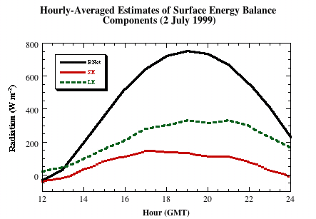
Basara and Crawford (2002)
Components of the Surface Energy Balance following a precipitation event of nearly 2 inches in a 24 hours period.

Slide 4
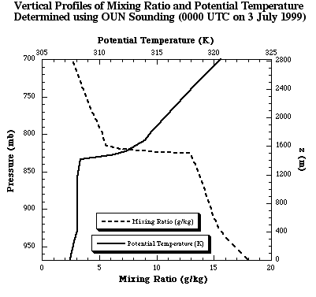
The Impact of Moist vs. Dry soils in PBL Development
PBL Depth
From Basara and Crawford (2002)

Slide 5
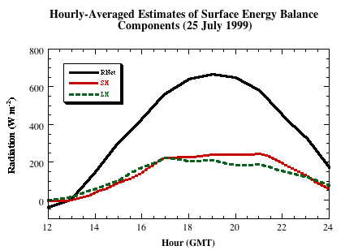
Basara and Crawford (2002)
Same Location - 3 weeks later after significant drying.

Slide 6
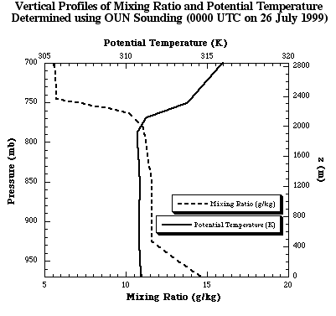
The Impact of Moist vs. Dry soils in PBL Development
PBL Depth
Basara and Crawford (2002)

Slide 7
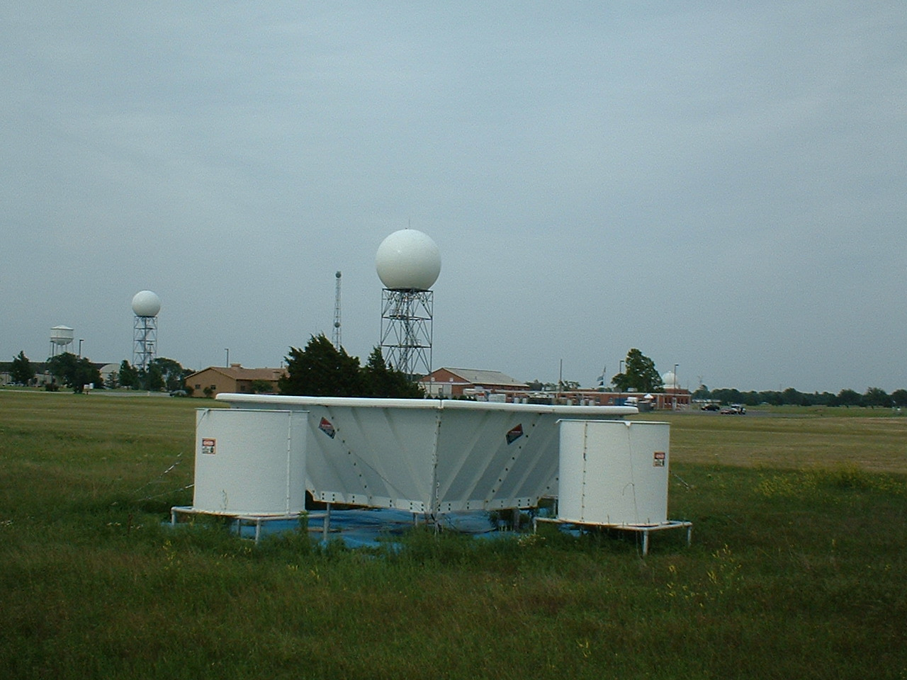
A PBL Tool: The Boundary Layer Profiler
Essentially a vertical-scanning radar operating at 915 MHz (~ 33 cm).
Scans in clear-air to a depth of nearly 3000 meters.

Slide 8
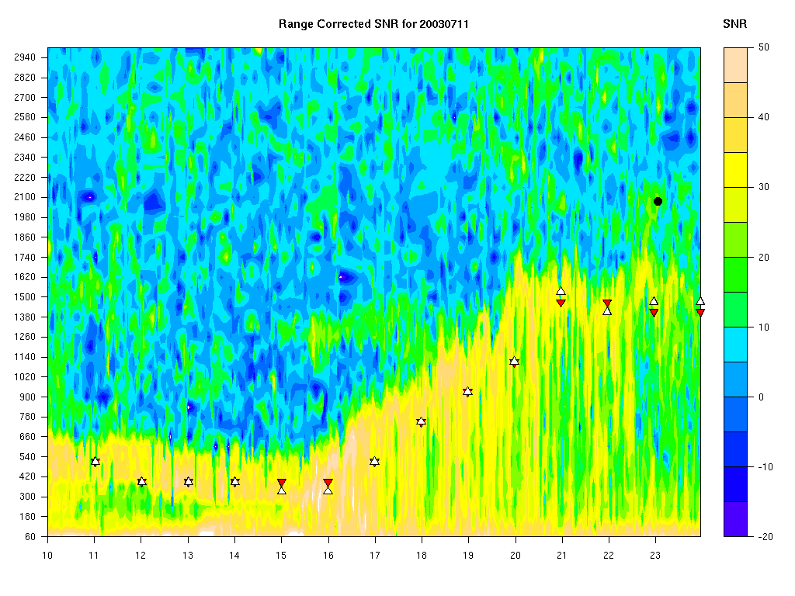
An Example of PBL Depth on 11 July 2003 in Norman, OK

Slide 9
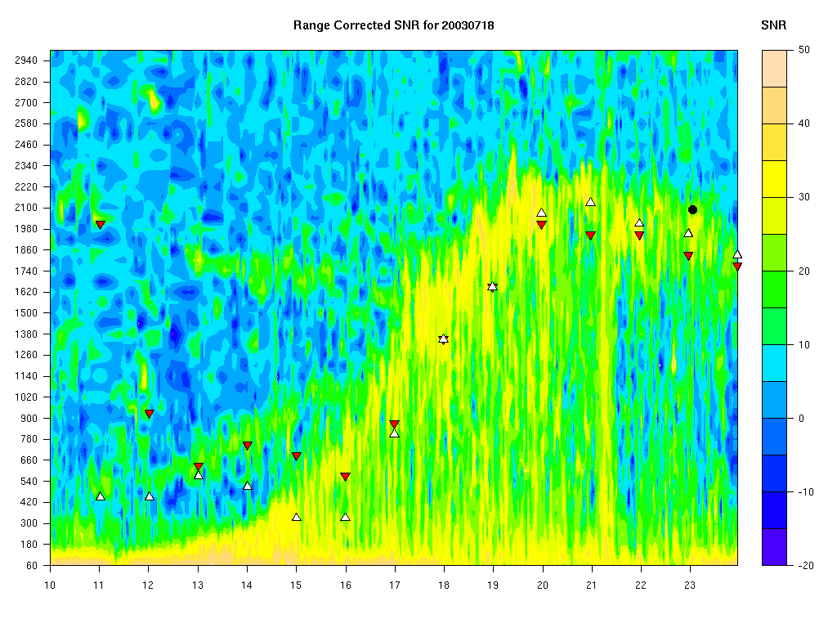
An Example of PBL Depth on 18 July 2003 in Norman, OK

Slide 10
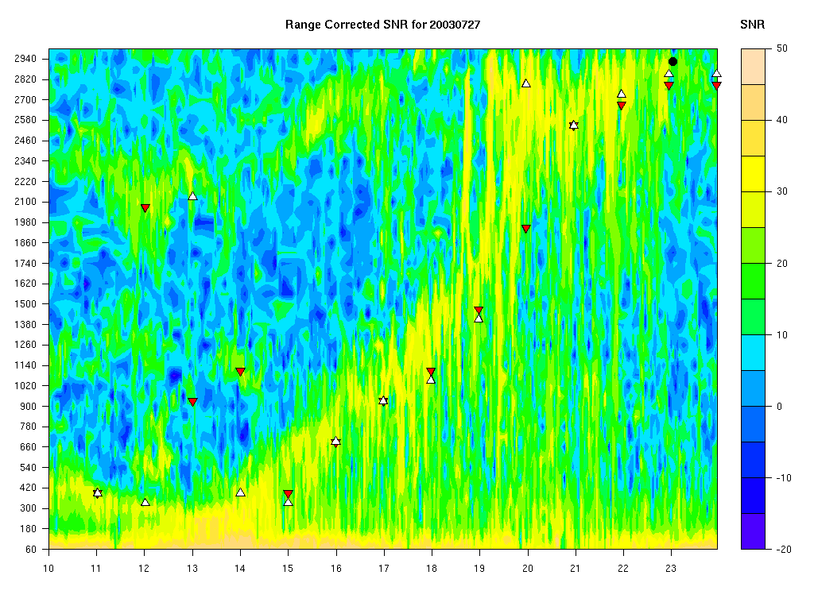
An Example of PBL Depth on 27 July 2003 in Norman, OK

Slide 11
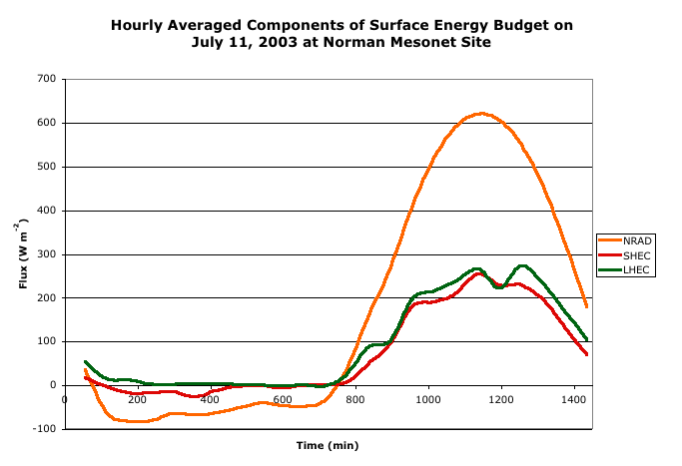
The Surface Heat Fluxes During the July 2003 Period
Initially, latent heat flux is greater due to residual moisture in the soil.
As the soil layer dries, sensible heating increases - PBL deepens.

Slide 12
Impacts on Typically Measured or Calculated Quantities
Moist Soil Conditions
Monthly-Averaged Diurnal Cycle of Mixing Ratio (g/kg) for Central Oklahoma
During August 1997
Dry Soil Conditions

Slide 13
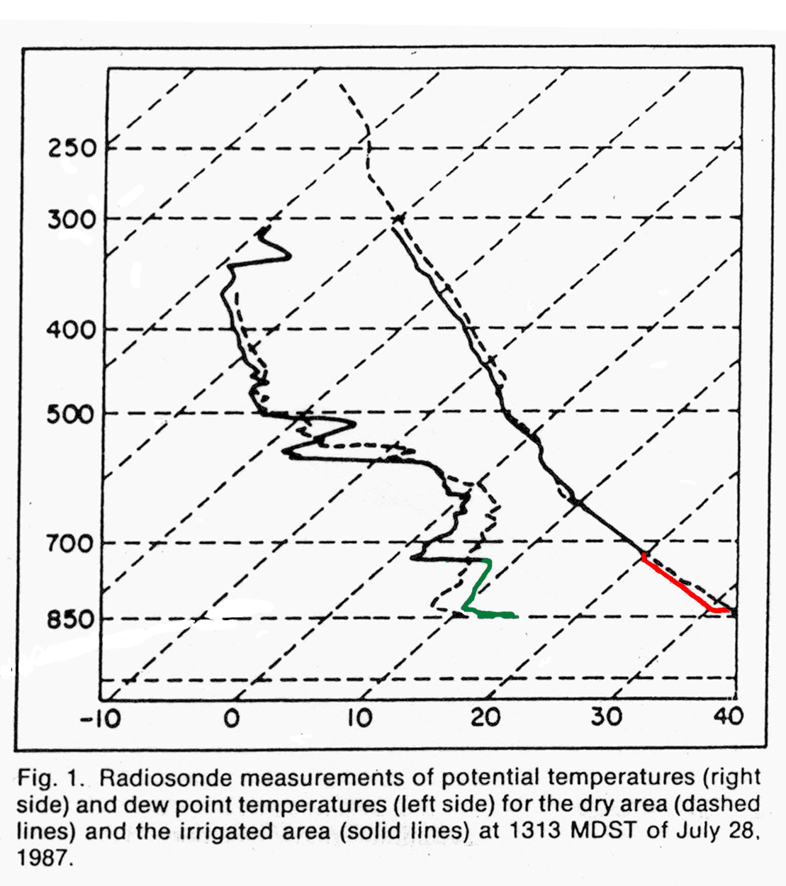
The Impact of Moist vs. Dry soils in PBL Development
Increased low-level moisture throughout the PBL for moist soils.
LI decreased (significantly) for moist soils.
LCL and PBL Depth reduced for moist soils.
Convective Potential (CAPE) enhanced over moist soils (even though surface temperatures are reduced).
Study over the high plains of Colorado
* Image From Pielke and Zeng (1989)
Dry PBL Depth
Moist PBL Depth

Slide 14
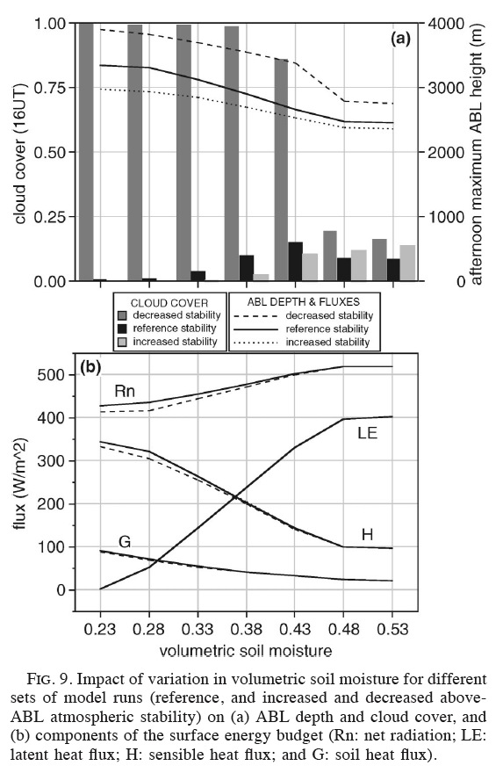
Numerical Study by Ek and Holtslag (2004) in the Netherlands Note how changes in soil moisture (x-axis) impacts numerous surface energy budget (bottom) and PBL (top) variables.
An absence of cloud cover? Why?

Slide 15
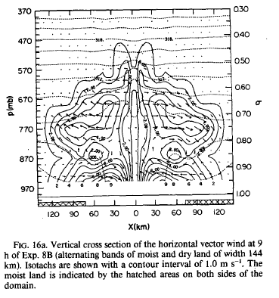
Land-Breeze Circulations*
For Dry Soil Surrounded by Moist Soil
Land-Breeze boundaries propagate from the moist soil region toward the dry soil region.
Convergence occurs over the dry soil region.
Note the divergence aloft.
* Simulations performed by Yan and Anthes (1988)

Slide 16
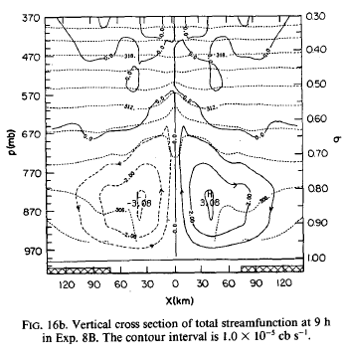
Land-Breeze Circulations*
For Dry Soil Surrounded by Moist Soil
Vertical Motion over the dry soil Region.
Net Effect => Precipitation.
The authors found that the land-breeze impact was maximized when the strips were approximately 150 km across (144 km used in the study).
* Simulations performed by Yan and Anthes (1988)

Slide 17
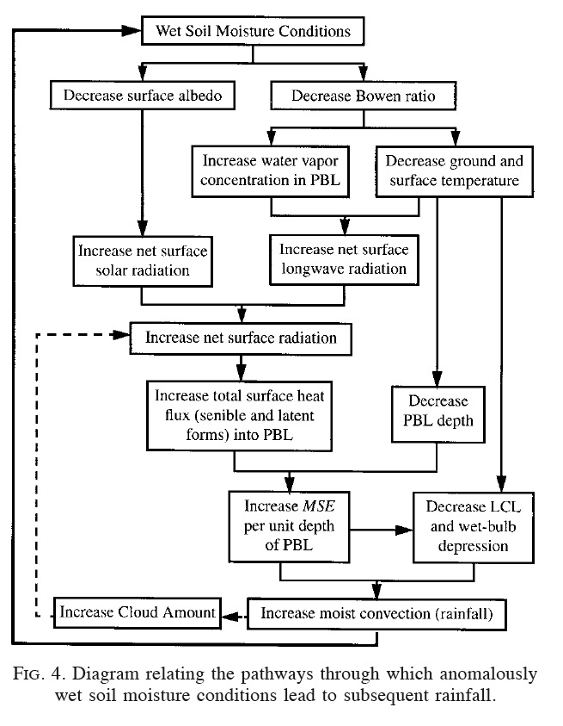
How soil moisture impacts not only the PBL, but also precipitation recycling. Pal and Eltahir (2001)

Slide 18
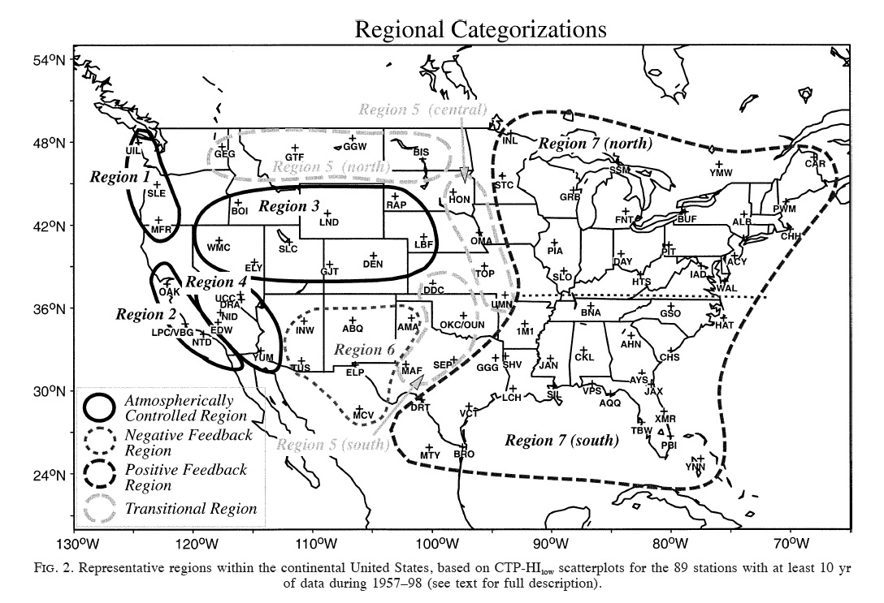
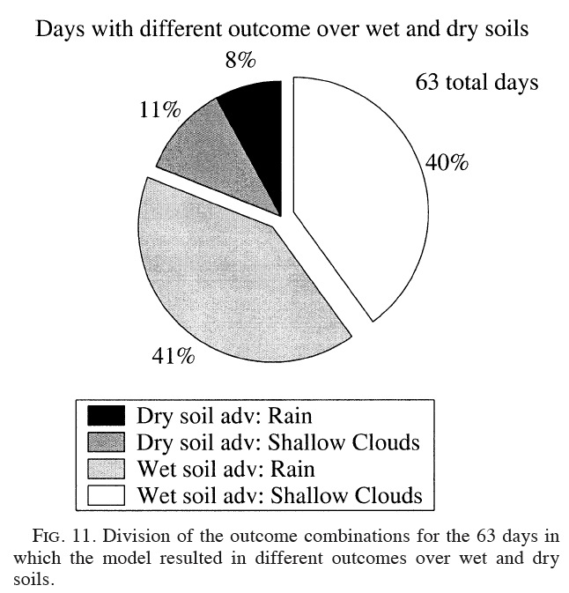
Clouds, Rain, and Soil Moisture (Findell and Eltahir 2003).

Slide 19
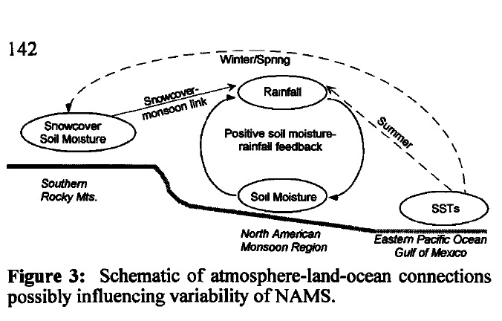
Soil Moisture’s Impact on the North American Monsoon (Small 2001).

Slide 20
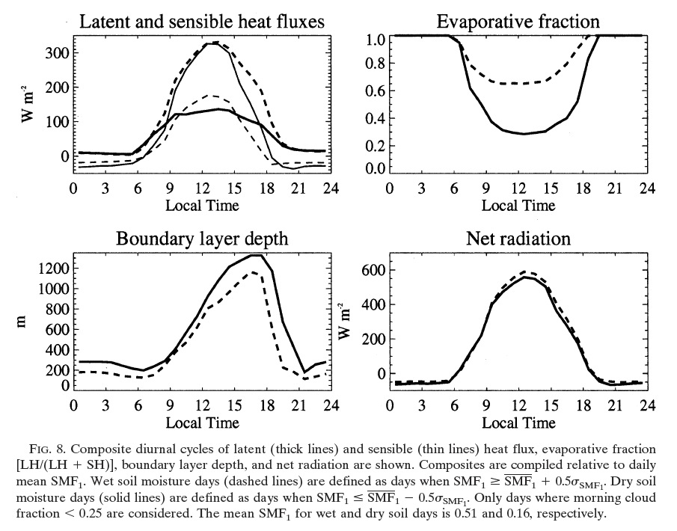
Lawrence and Slingo (2005) – Global Composite Values for Wet Versus Dry Soils

Slide 21
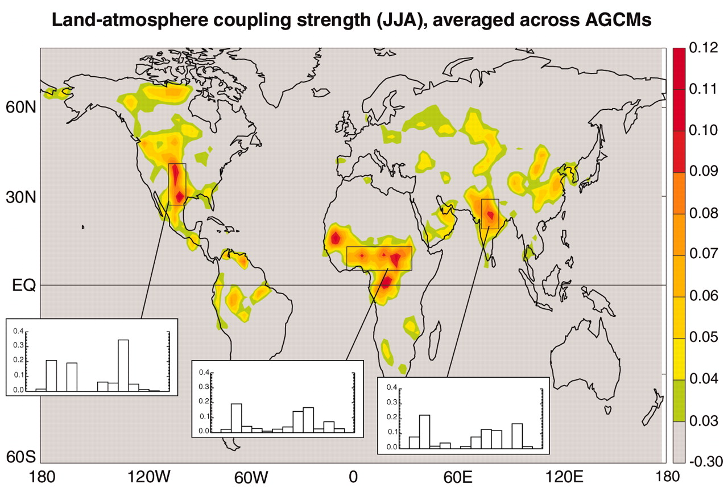
Example: Land-Atmosphere Coupling
The areas of the world with critical land-atmosphere coupling (Koster et al. 2004).

Slide 22
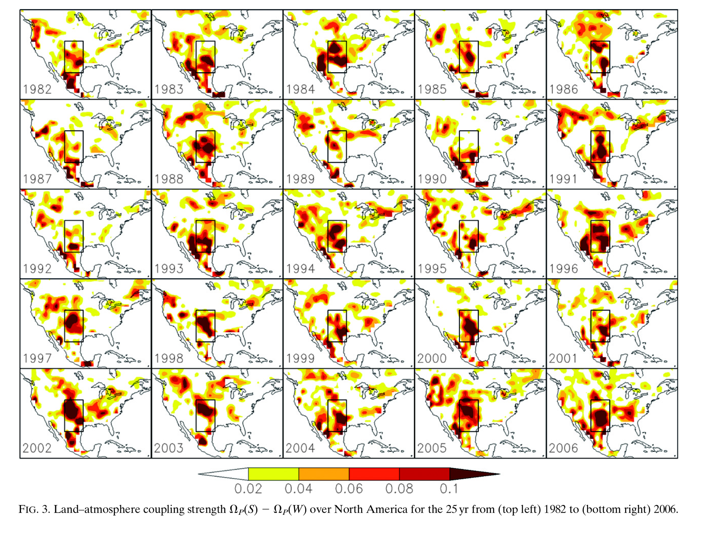
Guo and Dirmeyer (2013)

Slide 23
Summary – Soil Moisture
Soil moisture conditions are controlled by complex relationships between soil texture and the magnitude of the water in the soil.
It has a significant impact on the surface energy budget (SEB) and near-surface state variables.
On local scales, the soil moisture interactions with the SEB significantly impacts PBL development.
Can also impact large-scale features when land-atmosphere interactions dominate.

